Slide 1
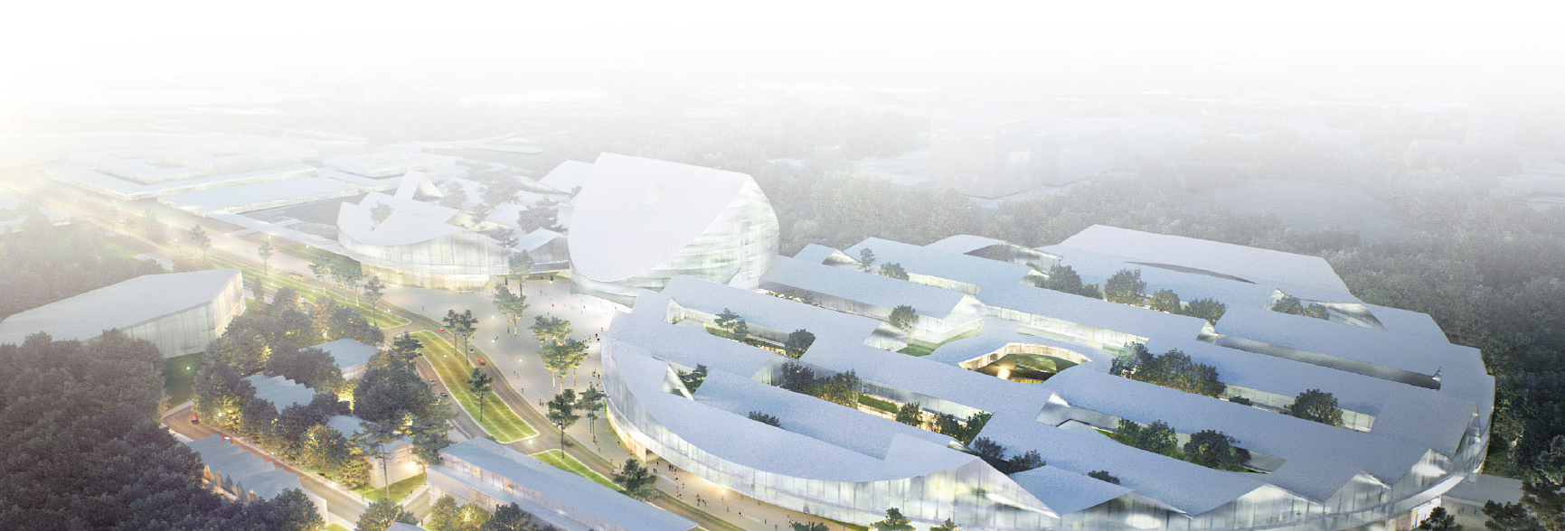
Skolkovo Tech: Overview and Update
Anna P. Ronell, MIT

Slide 2

VISION
The Skolkovo Institute of Science and Technology will be a central element of the innovation ecosystem of Skolkovo, attracting, educating and engaging the best talent from within the Russian Federation and overseas, interacting closely with research laboratories, ventures, enterprises and industrial partners, and helping to create a crucible of economic and entrepreneurial activity based on the application of science and technology.

Slide 3
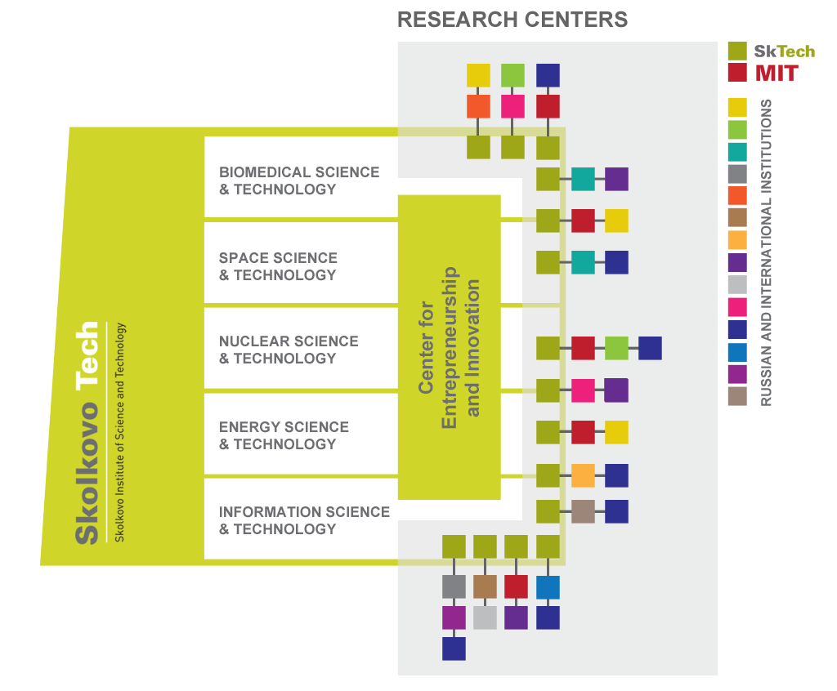

Slide 4
Blue Sky
Research
Value
Identification
Research
W/ consider
Of Use
Enterprise
Product
Develop.
Knowledge
Exchange &
Innovation
Manufacturing
Graduate
Education
Entrepreneur
Product
Development
Value
Delivery
University
Education
Developmental
Research
Infrastructure
(Physical capital)
Community
(social capital)
Capital
(financial)
Networks &
Workforce
(intellectual
capital)
Discover
ideas
Develop
technologies
Conceive
products
Design
products
Implement
products
Operate
products
Notes:
Please align the words at the bottom with the column they are supposed to be under

Slide 5

CENTERS FOR RESEARCH, INOVATION AND EDUCATION 1 ST ROUND
MARCH 2012
MAY 2012
JUNE 2012
129 teams from 350 universities submitted white papers
13 outstanding research proposals were selected as finalists
3 winners are being selected
Proposals were reviewed by 70 internationally recognized experts
Full proposals were due on June 1, 2012 and resulted in recommendations for funding and negotiations of contracts
As agreements are reached, the names of 3 winners will be announced

Slide 6
The first three CREIs
1. Infectious Disease and RNA Therapeutics, proposed by leading partners from the Massachusetts Institute of Technology (MIT), USA and Lomonosov Moscow State University (MSU), Russia, with participation from University of Texas Southwestern (UTS), USA
2. Stem Cell Research, proposed by leading partners from University Medical Centre Groningen, Netherlands and Vavilov Institute of General Genetics, Russia
3. Electro-Chemical Energy Storage, proposed by leading partners from the Massachusetts Institute of Technology, USA and Lomonosov Moscow State University (MSU), Russia

Slide 7
New Faculty at Skolkovo Tech
Alessandro Aliakbargolkar (Space) received his PhD from MIT and he focuses on the development of systems engineering tools and methodologies for architecting large engineering systems, including applications for robotic space exploration, human spaceflight, satellite systems and energy infrastructures.
Victor Lempitsky (IT/Software) Victor received his PhD from Moscow State and has worked as a researcher in various locations including Yandex, the University of Oxford, and at Microsoft Research Cambridge. His interests are in computer vision, visual recognition, and biomedical image analysis.

Slide 8
New Faculty at Skolkovo Tech
Julia Stoyanovich (IT/Software) received her PhD from Columbia University and focuses on data and knowledge management, developing novel information discovery approaches, with the goal of helping the user identify relevant information, and ultimately transform that information into knowledge.
Yuri Shprits (Space) received his PhD from UCLA, he studies the dynamics of the energetic particle populations, which are harmful to satellites and humans in the near-Earth space environment. In particular, he focuses on understanding, predicting, and mitigating space hazards.

Slide 9
Faculty Fellows at Skolkovo Tech
Vadim Gladyshev Professor of Medicine, Genetics Division, Department of Medicine, Brigham and Women’s Hospital, Harvard Medical School; Director, Center for Redox Medicine; Associate Member, Broad Institute; Full Member, Dana Farber Cancer Center
Zinetula Z. Insepov Computational Materials Scientist, Mathematics & Computer Science Division, Argonne National Laboratory; Adjust Professor, School of Nuclear Engineering, Purdue University

Slide 10
Faculty Fellows - Continued
Konstantin Severinov Professor, Waksman Institute, Department of Molecular Biology and Biochemistry, Rutgers; Head of Laboratory of Molecular Genetics of Microorganisms, Institute of Gene Biology, Russian Academy of Sciences; Head of Laboratory of genetic regulation of prokaryotic mobile genetic elements, Institute of Molecular Genetics, Russian Academy of Sciences
Berloff Natalia Director of the Quantum Fluids Laboratory, Department of Applied Mathematics and Theoretical Physics, University of Cambridge; Fellow and Director of Studies of Jesus College, Cambridge. Scientific interests include coherence in non-equilibrium quantum systems, finite temperature atomic condensates, superfluid helium, driven quantum systems and superfluid turbulence.

